Slide 1
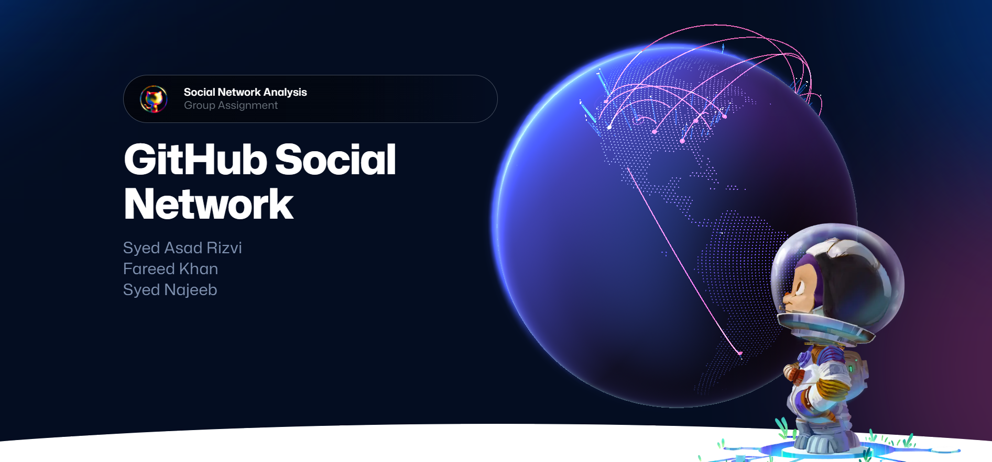

Slide 2
Agenda
Introduction
Dataset
Observations & Insights
Summary

Slide 3
Introduction
Analysis of GitHub social network of developers.
Discovers hidden information and relationships among different developers.
NetworkX Python library used for analysis.
Figuring out popular developers and topological structure of network.

Slide 4
Dataset
A large social network of GitHub developers.
Undirected graph with 37,700 nodes with 289,003 edges.
Nodes (users) are either web or machine learning developers.
Each user has starred at least 10 repositories.

Slide 5
Observations & Insights
Structural Measures:
Network Density: 0.00040668
nx.density(mydata)
It indicates the low fraction of existing links between GitHub users with respect to the possible links.
Diameter: 11
nx.diameter(mydata)
It illustrates that a developer has to visit maximum 11 profiles to reach another developer having a mutual follower.
Radius: 6
nx.radius(mydata)
It illustrates that a developer has to visit minimum 6 profiles to reach another developer having a mutual follower.

Slide 6
Observations & Insights
Average Path Length: 3.247
nx.average_shortest_path_length(mydata)
It indicates that on average, one developer have mutual followers to another in approximately 3 steps.
Clustering coefficients:
Local: nx.clustering(mydata)
Global: nx.average_clustering(mydata)
Value: 0.167
Almost 16% developers are those who have a chance
of a connection between their individual followers.
Name | Local Clustering
caseycavanagh | 0.333333
Injabie3 | 0.000000
qpautrat | 0.000000
kris-ipeh | 0.000000
shawnwanderson | 0.000000
... | ...

Slide 7
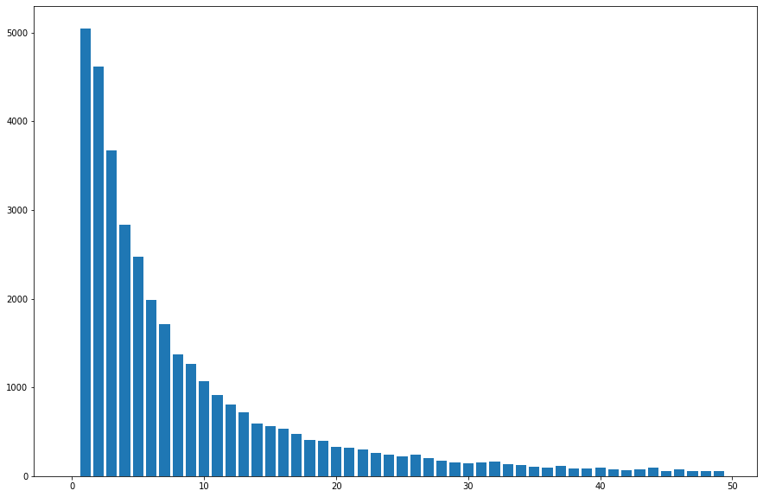
Observations & Insights
Connected Components: 1
nx.number_connected_components(mydata)
We only have a single cycle within the whole network.
Degree Distribution:
nx.degree_histogram(mydata)
It indicates that most of the developers
have only a few number of followers.

Slide 8
Observations & Insights
Eccentricity:
nx.eccentricity(mydata)
Majority number of nodes have eccentricity value of 7. This indicates that a developer must visit 7 profiles to find a mutual follower.
Eccentricity | Total Number of Nodes
7 | 27399
8 | 8677
6 | 1113
9 | 480
10 | 27
11 | 4

Slide 9
Observations & Insights
Centrality Measures:
Degree Centrality:
nx.degree_centrality(mydata)
Those who have a higher number of degree centrality have a higher number of followers. Through this we can work out the celebrity developer.
Name | Degree Centrality | ml_target
dalinhuang99 | 0.250882 | 0
nfultz | 0.187936 | 0
addyosmani | 0.088172 | 0
Bunlong | 0.078464 | 0
gabrielpconceicao | 0.065466 | 0
... | ... | ...

Slide 10
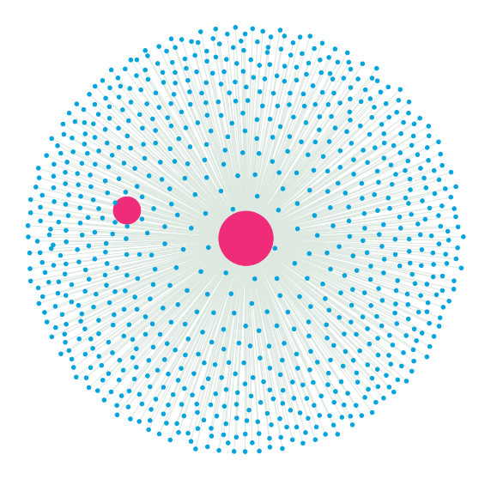
Degree Centrality:
nfultz
dalinhuang99

Slide 11
Closeness Centrality:
nx.closeness_centrality(mydata)
Closeness Centrality illustrates how close a developer is to all other developers in the network
Name | Closeness Centrality | Ml_target
nfultz | 0.523081 | 0
dalinhuang99 | 0.517787 | 0
Bunlong | 0.466324 | 0
addyosmani | 0.450342 | 0
gabrielpconceicao | 0.447461 | 0
... | ... | …

Slide 12
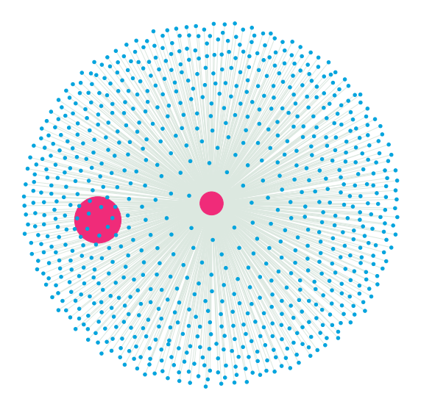
Closeness Centrality:
dalinhuang99
nfultz

Slide 13
Betweenness Centrality:
nx.betweenness_centrality(mydata)
Betweenness Centrality illustrates which node is acting as a connector between all the other nodes in the network so as to transfer the flow of information between two sub groups.
Name | Betweenness Centrality | ml_target
dalinhuang99 | 0.269599 | 0
nfultz | 0.240541 | 0
Bunlong | 0.055323 | 0
addyosmani | 0.043408 | 0
gabrielpconceicao | 0.035337 | 0
... | ... | …

Slide 14
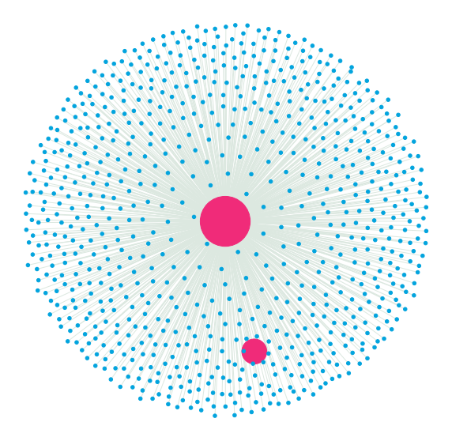
Betweenness Centrality:
dalinhuang99
nfultz

Slide 15
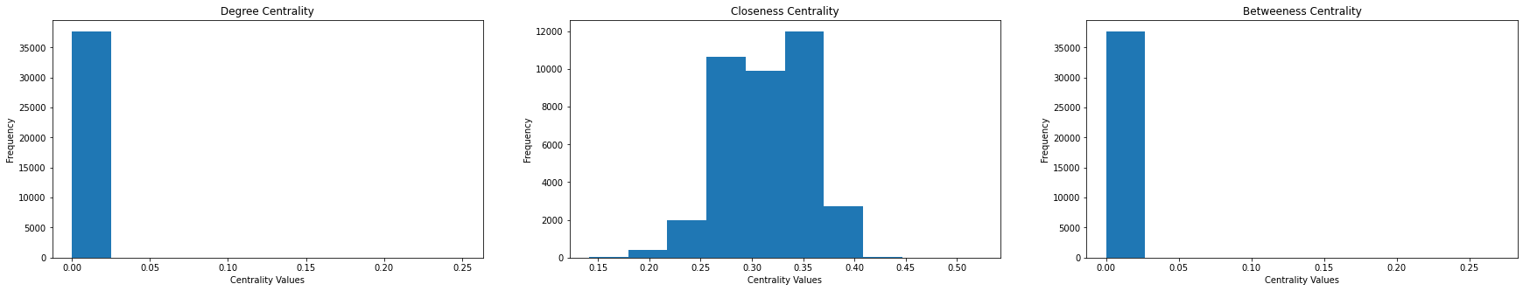
Centrality Distribution:

Slide 16
Summary
1. Who is the “celebrity” in the GitHub social network by different measures?
According to Degree and Betweenness Centrality Measures, dalinhuang99 user is the most popular developer, whereas based on Closeness Centrality, nfultz is the most popular developer in the GitHub social Network.
2. Are web people generally more popular than machine learning people? Or else?
Based on each Centrality Measure, Web developers are more popular as compared to ML developers. This is because our dataset is uneven, consisting of 75% Web developers and 25% ML developers.

Slide 17
Thank You!

